Slide 1
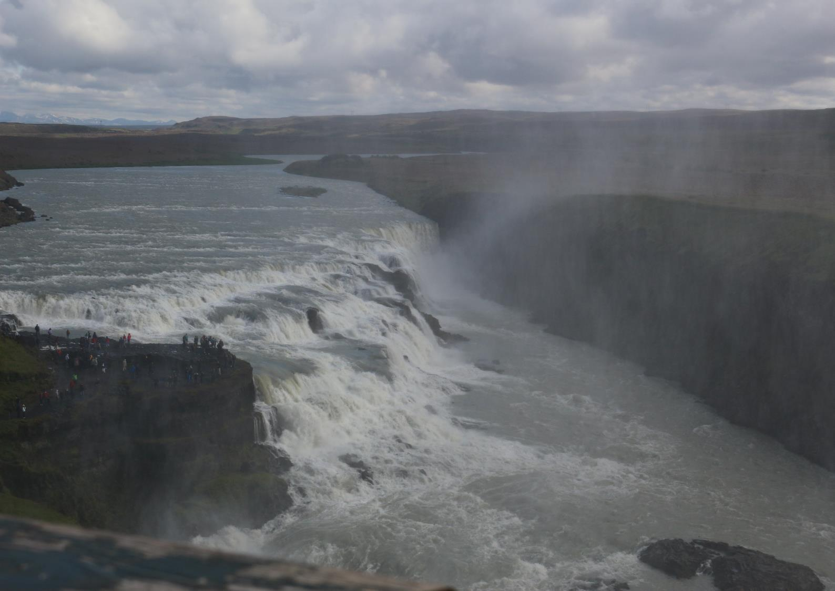
Hear the Land Speak
Virtual Pilgrimage
Gulfoss

Slide 2
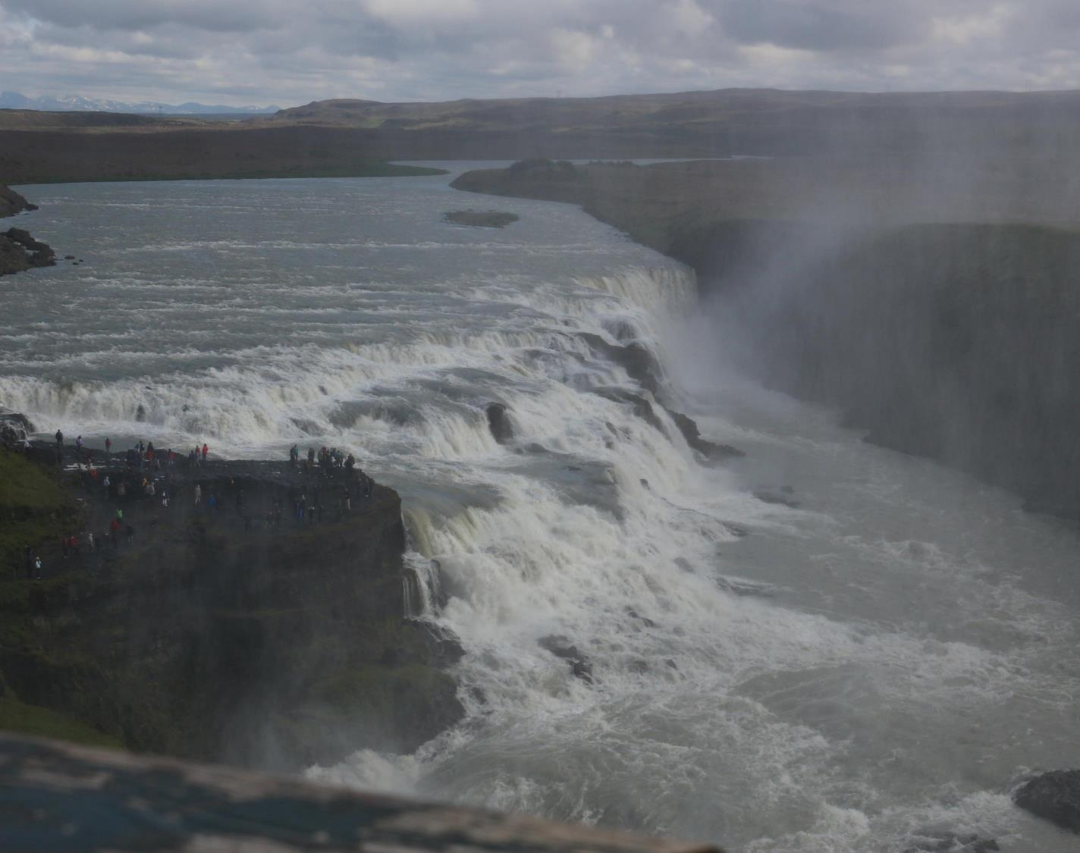
“Hear the Land Speak”
Each Session offers you:
Some photographs to show you the place we are focusing on.
A little about its significance. (This could be a little on the geography/ history
A passage from Scripture. (You may think of others you would like to pray with).
Thoughts or questions for you to take outside to hear the land near you speak.
A closing prayer.

Slide 3
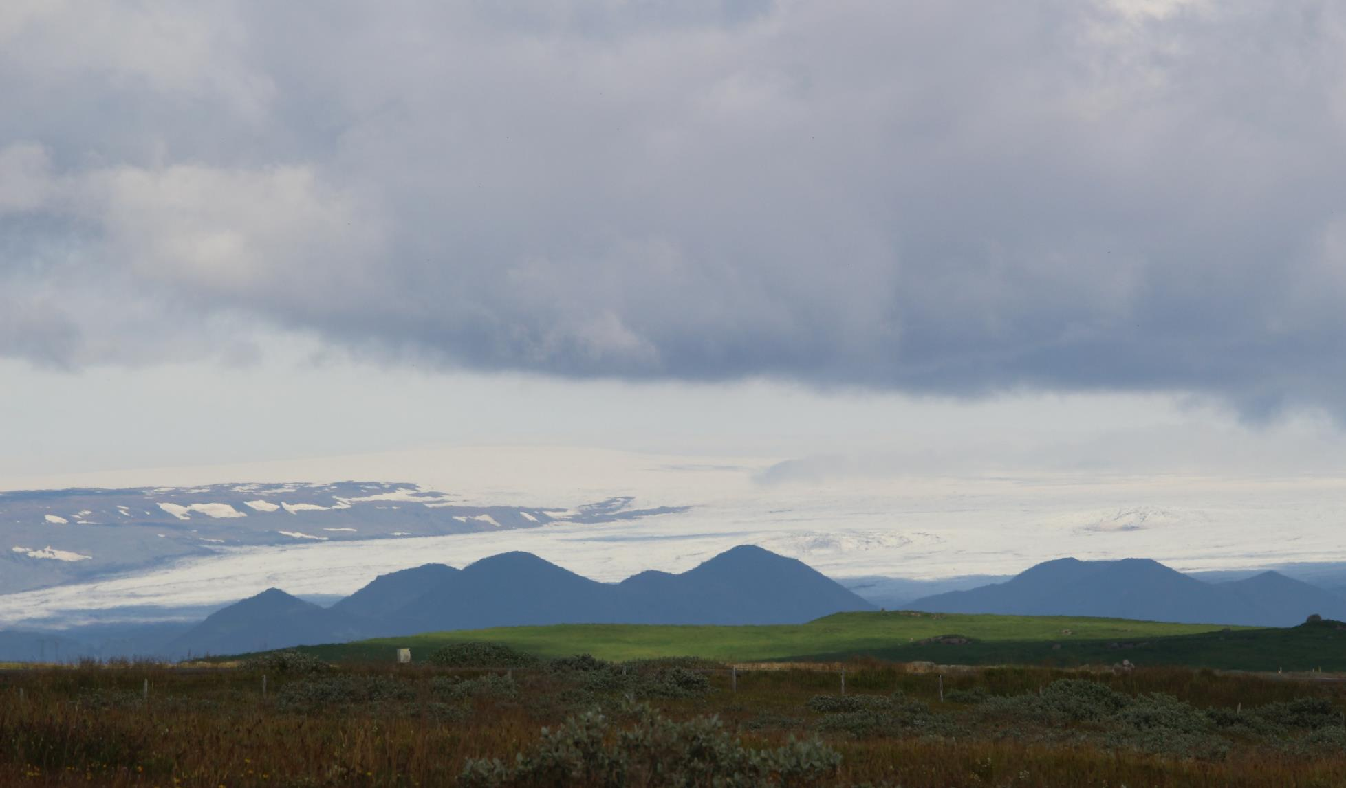
Looking to the north of Gulfoss, we catch glimpses of Langjökull, the ‘Long Glacier’,
the second-largest glacier in Iceland, at 935 square kilometres.
Water locked in ice – working slowly and powerfully across a landscape.

Slide 4
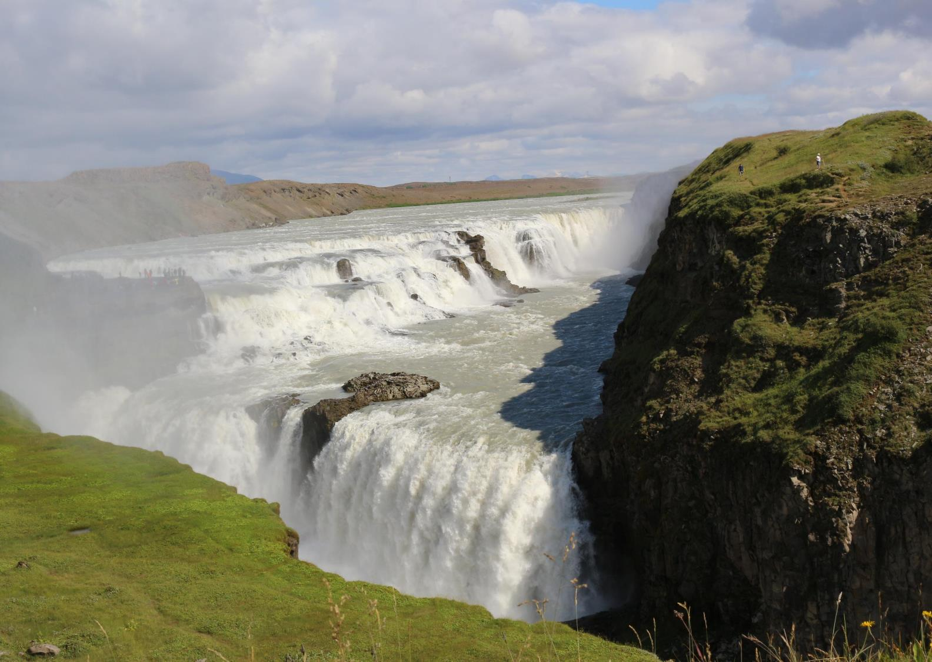
Living Waters
At Gulfoss, the Hvítá river flows down into a wide curved three-step "staircase“.
It plunges 11 metres and then 21 metres into a crevice 32 metres deep.
The average amount of water running down the waterfall is 141 cubic metres per second
The highest flood measured was 2,000 cubic metres per second.

Slide 5
The power of the water led some people to want to harness it to generate electricity.
But the waterfall is now owned by Iceland and is protected.
The next slide is a video – giving you an indication of the size and power of the waterfalls

Slide 7
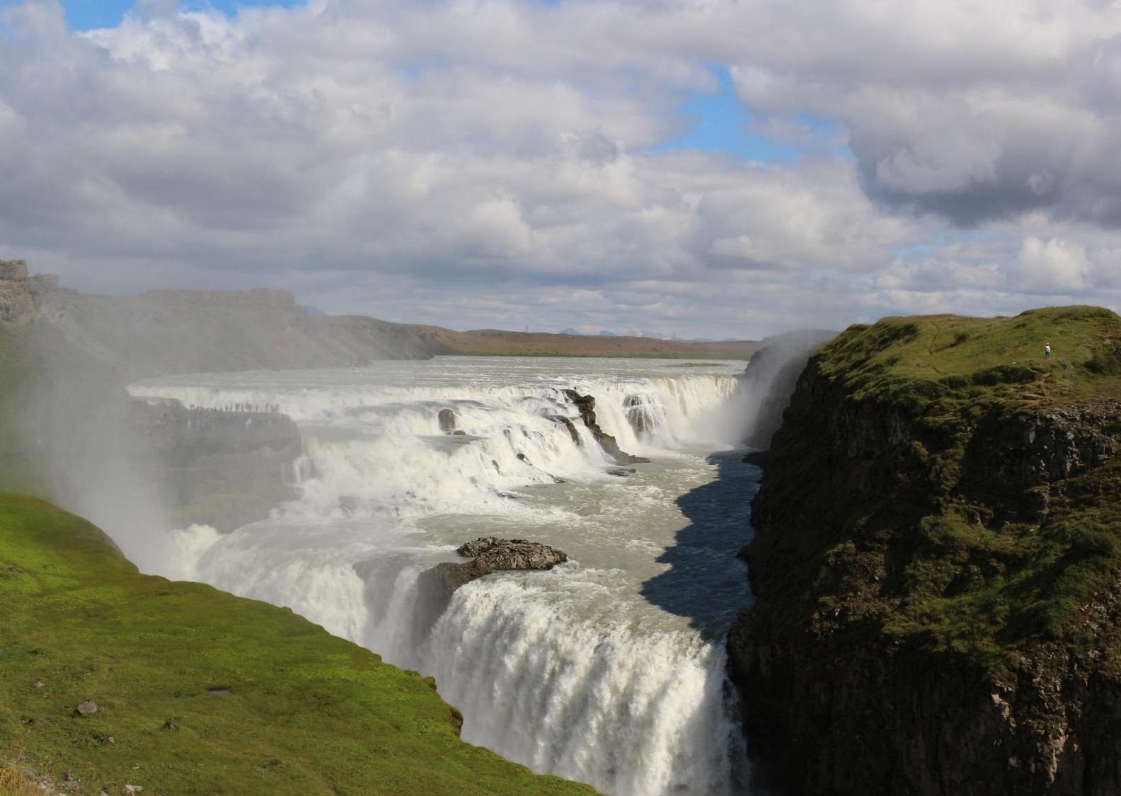
The Lord is king, he is robed in majesty; the Lord is robed, he is girded with strength. He has established the world;it shall never be moved; your throne is established from of old; you are from everlasting.

Slide 8
The floods have lifted up, O Lord, the floods have lifted up their voice; the floods lift up their roaring. More majestic than the thunders of mighty waters, more majestic than the waves* of the sea, majestic on high is the Lord!

Slide 9
Your decrees are very sure; holiness befits your house, O Lord, for evermore.
Psalm 93

Slide 10
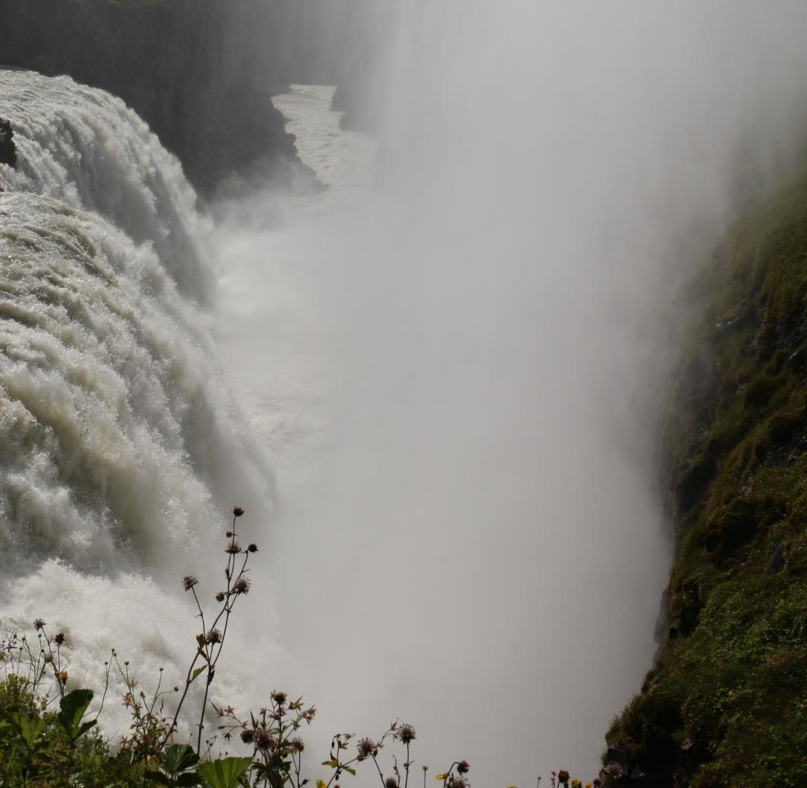
My Gulfoss
If you are able, go to a waterfall – or a river – or to the sea.
Watch and listen to the movement of the water. Imagine the waters you see connected to Gulfoss and to all the waters of the earth.
Hear the Land Speak – in the sound of the water…

Slide 11
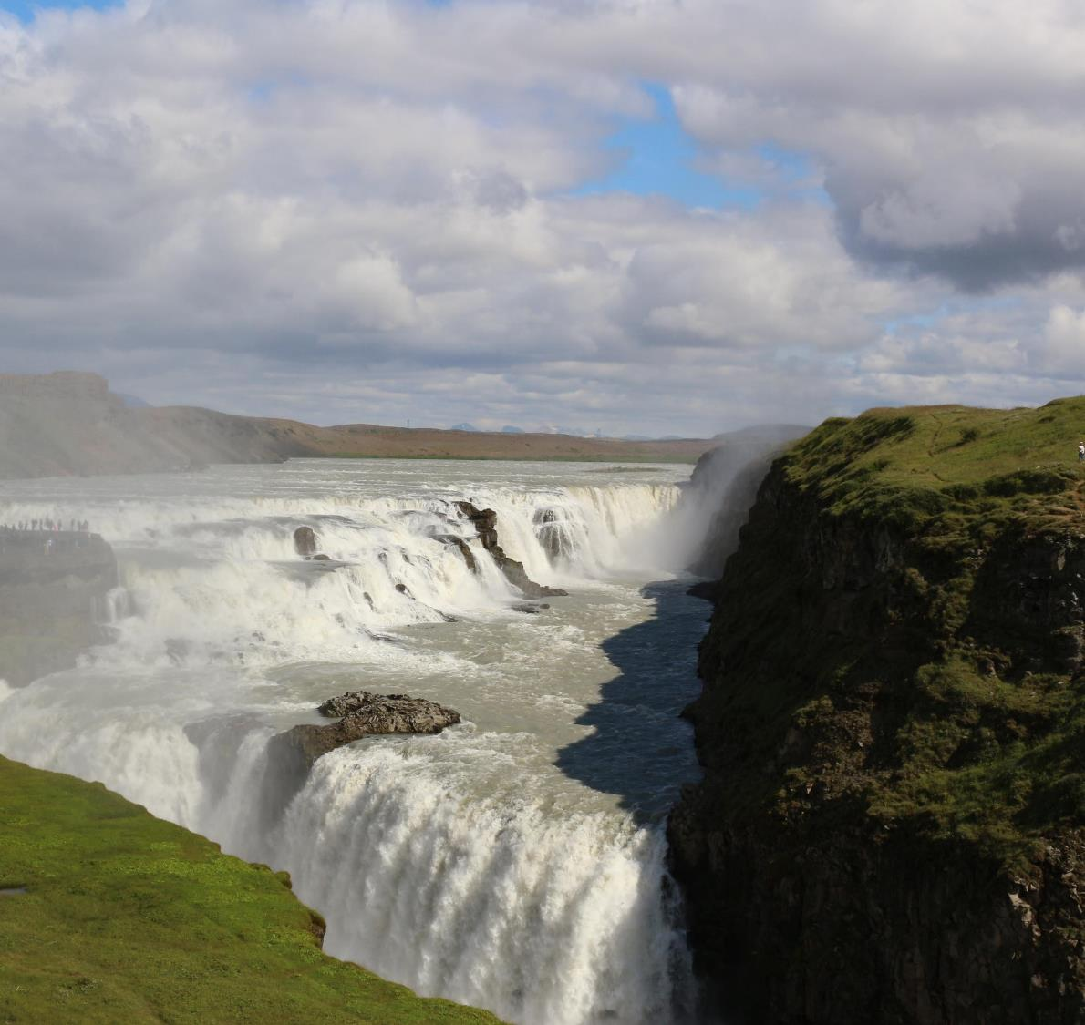
God and Creator
Thank you for giving us clean water in this country, both hot and cold.
Thank you for this waterfall Gullfoss which is a beautiful example of your creation and it shows us the power of your glory.
We ask you to bless every source of water in this country and throughout the World.
Bless every drop and help us to keep it clean.
Thank you for your living water and please continue your good work in us that we may have rivers of your living water flowing from our hearts.
Thank you Lord for hearing our prayers.

