Slide 1
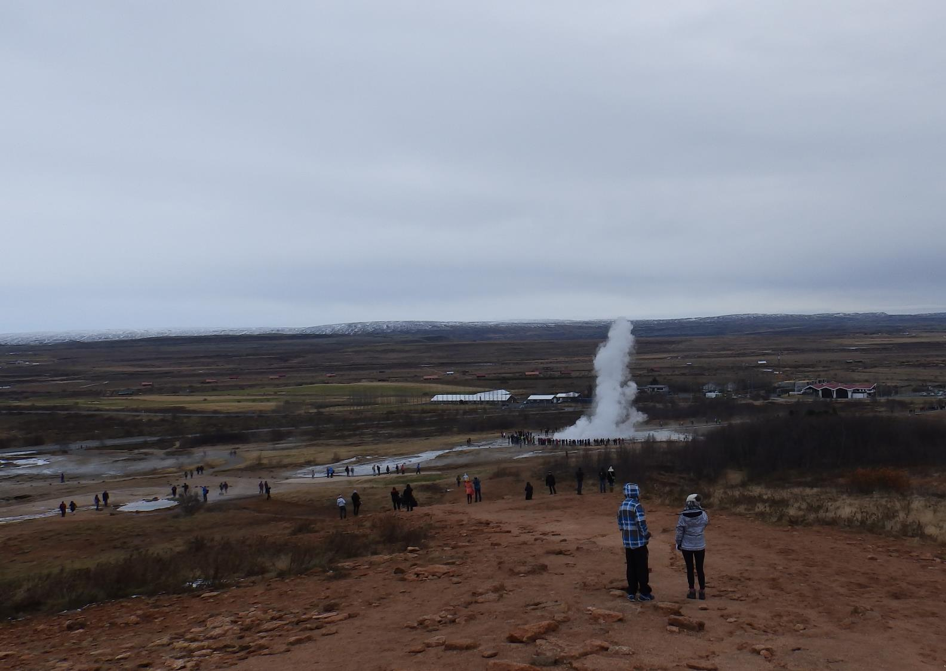
Hear the Land Speak
Virtual Pilgrimage
Geysir

Slide 2
“Hear the Land Speak”
Each Session offers you:
Some photographs to show you the place we are focusing on.
A little about its significance. (This could be a little on the geography/ history)
A passage from Scripture. (You may think of others you would like to pray with).
Thoughts or questions for you to take outside to hear the land near you speak.
A closing prayer.
Photo: Skálholt church from Long House

Slide 3
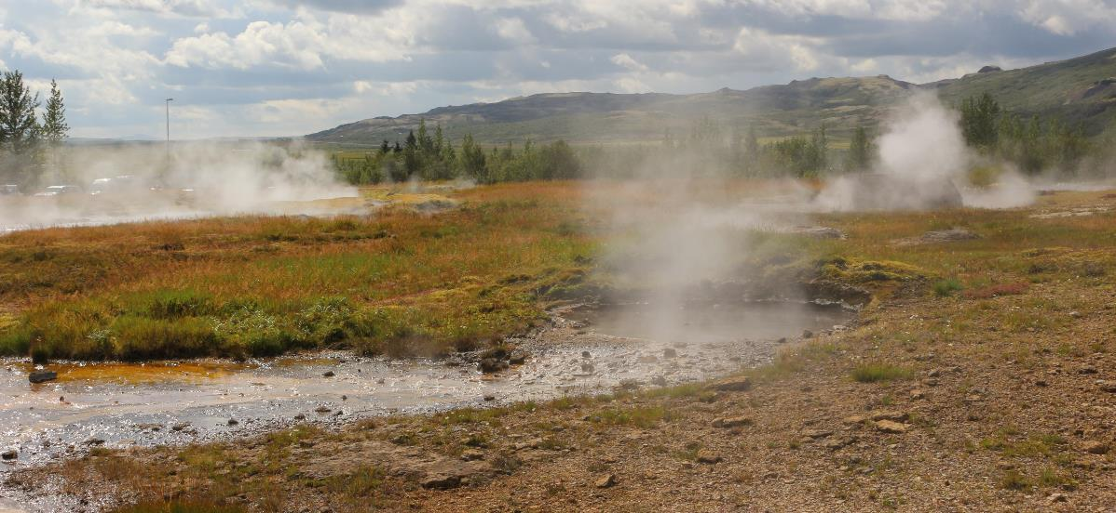
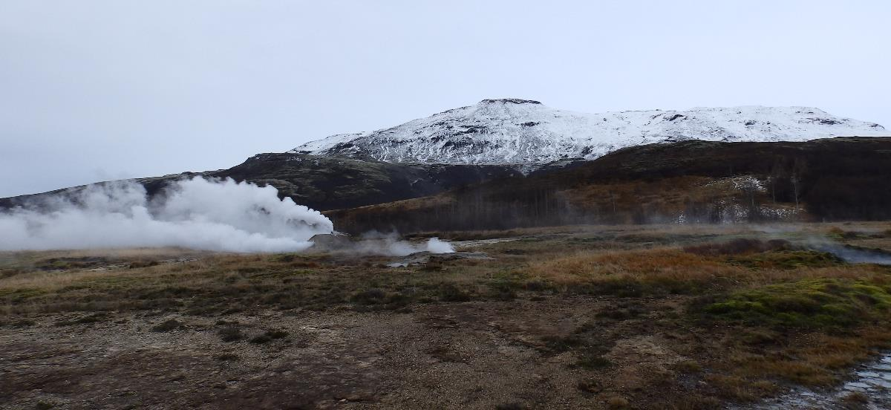
Feeling the Energy…
Many places in Iceland have hot springs.
Some of the springs simply bubble.
Some give off steam which creates a unique environment – in the winter, truly a Land of Ice and Fire.

Slide 4
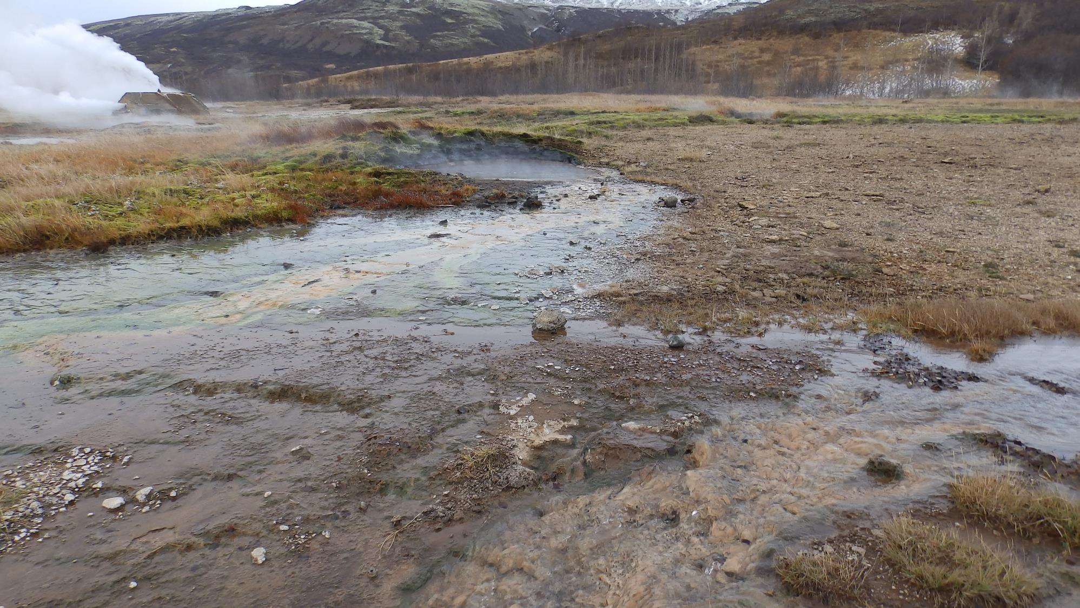
There are streams of near-boiling water.
Astonishingly, some plants have adapted to survive.
Reflect for a few minutes on the adaptability of species on the earth.

Slide 5
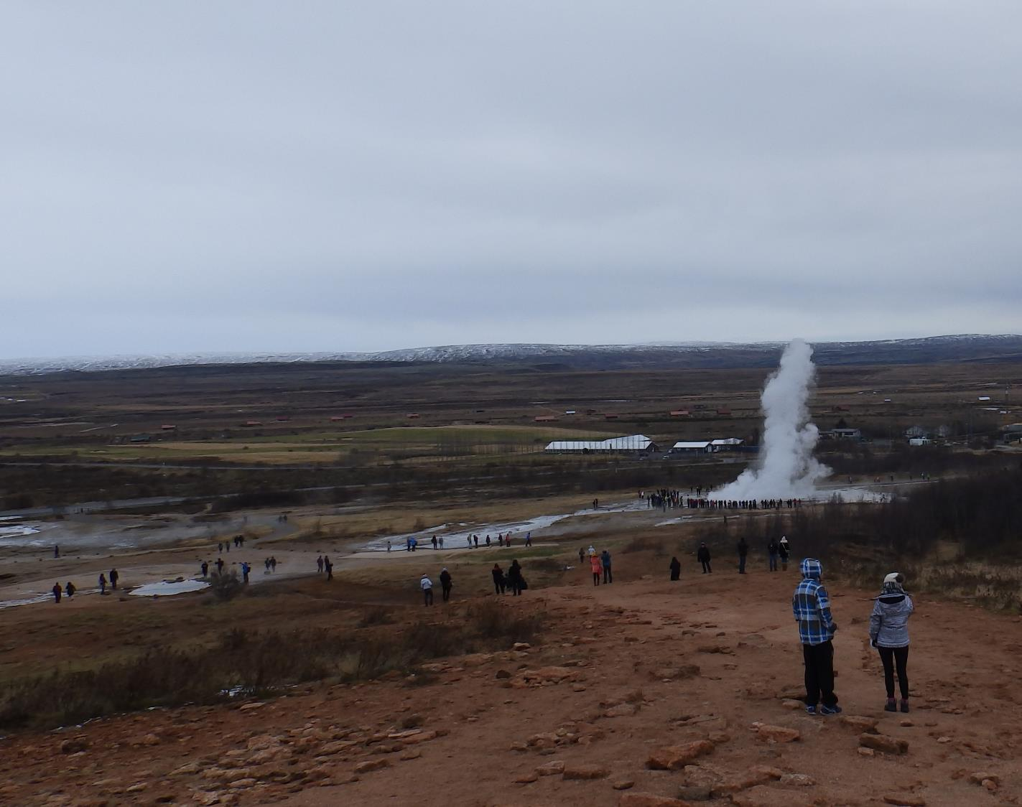
At Geysir, there is Strokkur – a geysir that erupts every few minutes.
It reminds us of the enormous energy within the earth.
The following slide has a video.
Share the patience as we wait …
And then sense the energy and power of water and steam as the geysir erupts.

Slide 7
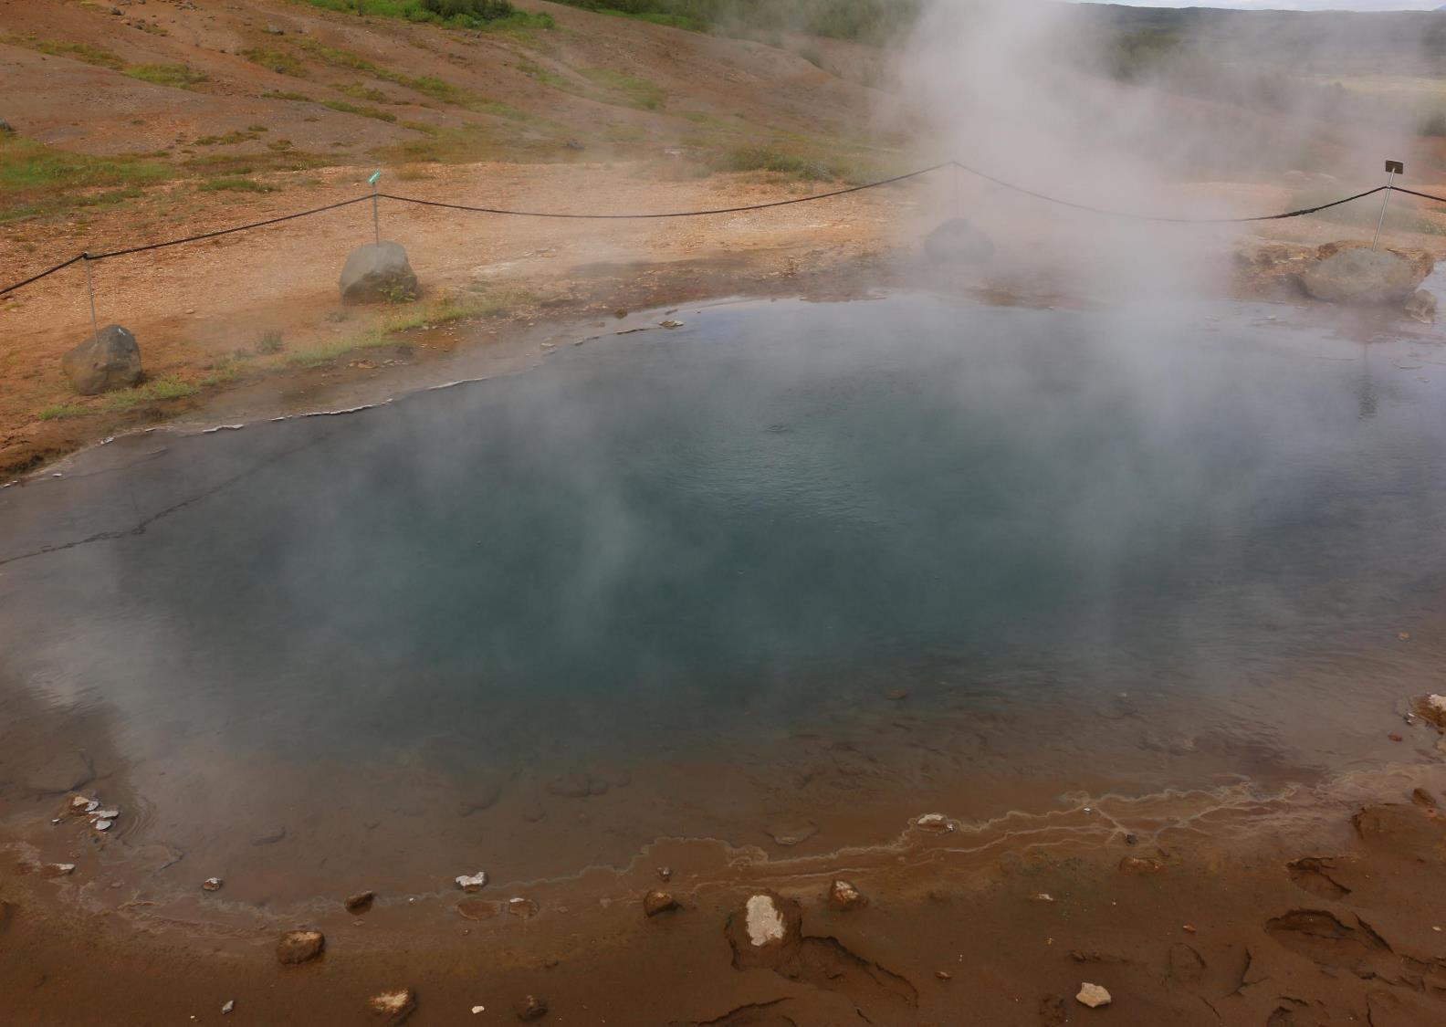
Iceland is place where we encounter the power of nature – as Elijah did.
Yet deep within the power is a deeper silence – deeper than the absence of sound.

Slide 8
He said, ‘Go out and stand on the mountain before the Lord, for the Lord is about to pass by.’ Now there was a great wind, so strong that it was splitting mountains and breaking rocks in pieces before the Lord, but the Lord was not in the wind; and after the wind an earthquake, but the Lord was not in the earthquake; and after the earthquake a fire, but the Lord was not in the fire; and after the fire a sound of sheer silence. When Elijah heard it, he wrapped his face in his mantle and went out and stood at the entrance of the cave.
1 Kings 19:11-13

Slide 9
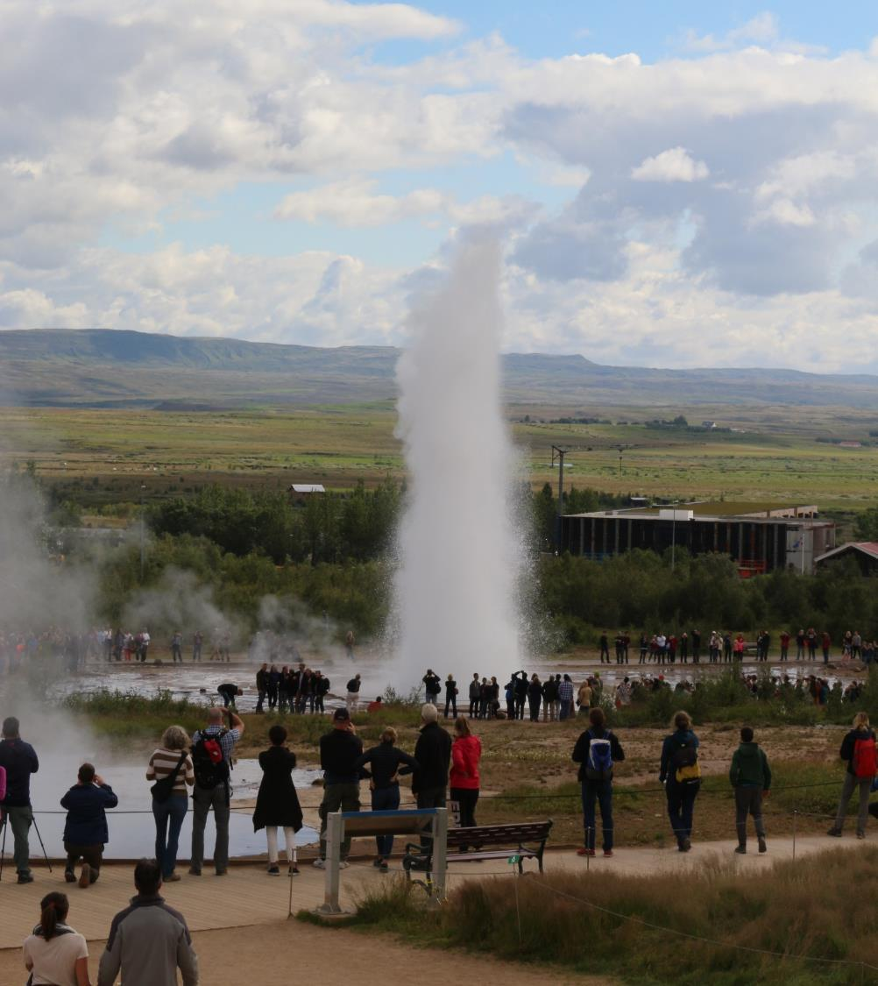
My Geysir
If you are able, go to a beach, a beauty spot or a park or somewhere else where people gather for enjoyment and excitement. Choose a place there where you can be aware of all that is going on – but where you can be still.
Hear the Land Speak – in the voices – and the noises of the nature around you.
Hear the Land Speak – within you – in the silence that goes deeper than the noise and excitement around you.

Slide 10
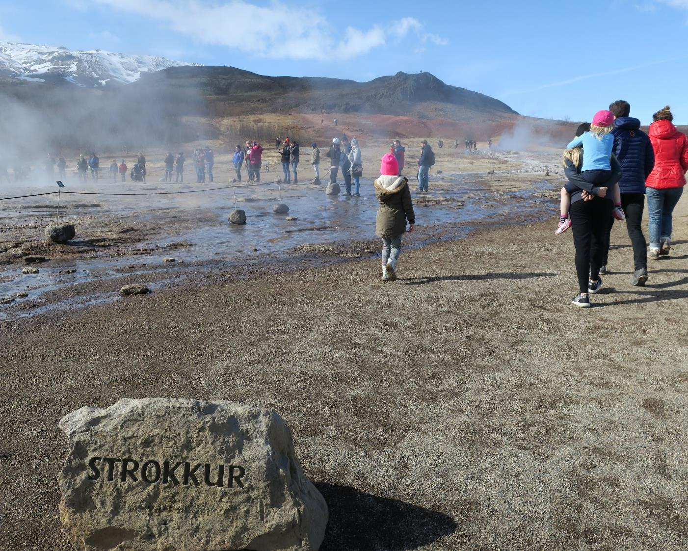
Prayer of the Pilgrim
I commence my journey
Jesus in your name.
Your holy hand will lead me
from every danger guide me.
In peace I travel with Jesus
and a beautiful flock of angels.
In danger, puzzle and trouble
you are my chosen companion.
Always watching over me
and in need you caution me.
In peace I travel with Jesus
and a beautiful flock of angels.

