Slide 1
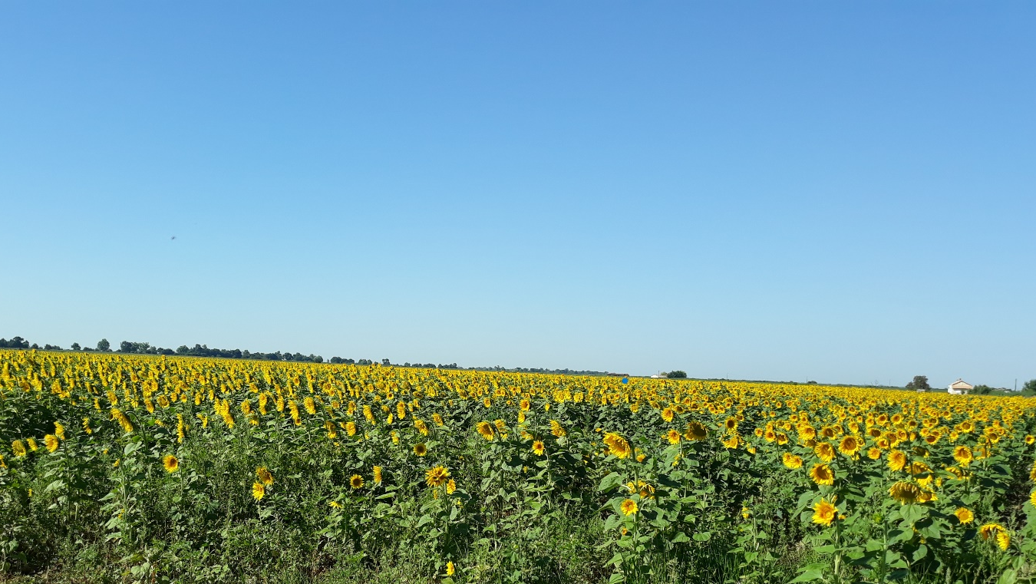
A Liturgy for Peace
In Ukraine and all parts of the world where people suffer from war.

Slide 2
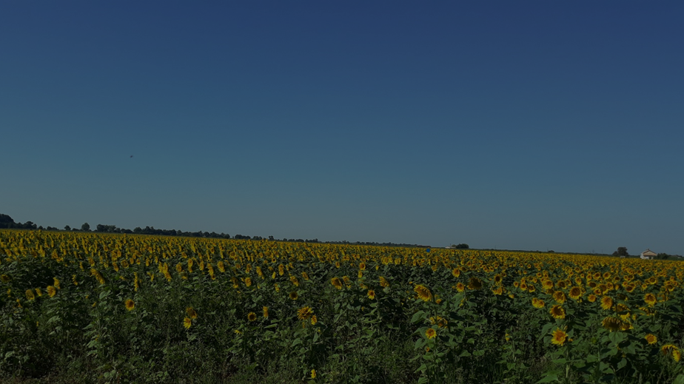
Opening Responses
Voice 1 We gather in the name of the Father:
Who created the sun to give light and warmth to the children of the earth.
All But, Father, that light is veiled by the clouds of war:
The dust of bombings;
The darkness of fear;
The fogs of lies and confusion:
And the children of your earth are afraid.

Slide 3
Opening Responses
Voice 1 We gather in the name of the Son:
The one who rose with a new dawn for humanity.
All And yet, Lord Jesus –
Where does the light of your resurrection shine
in a world filled with death and destruction?
Lord Jesus, we yearn for the lights of peace and of hope.

Slide 4
Opening Responses
Voice 1 We gather in the name of the Holy Spirit:
Whose gifts are wisdom and knowledge,
right judgement and fortitude,
understanding and fear of the Lord
All But, Spirit of God,
The gifts you pour out with such grace and generosity
are squandered and abused
by those who use them to make war on innocence.
Blessed Spirit, shine the light of your gifts into the cold hearts of men –
Kindle in them the fire of your love for all peoples.

Slide 5
From the Word of God
God is our refuge and strength,
a very present help in trouble.
Therefore we will not fear, though the earth should change,
though the mountains shake in the heart of the sea;
though its waters roar and foam,
though the mountains tremble with its tumult.
Selah

Slide 6
From the Word of God
There is a river whose streams make glad the city of God,
the holy habitation of the Most High.
God is in the midst of the city; it shall not be moved;
God will help it when the morning dawns.
The nations are in an uproar, the kingdoms totter;
he utters his voice, the earth melts.
The Lord of hosts is with us;
the God of Jacob is our refuge.
Selah

Slide 7
From the Word of God
Come, behold the works of the Lord;
see what desolations he has brought on the earth.
He makes wars cease to the end of the earth;
he breaks the bow, and shatters the spear;
he burns the shields with fire.
‘Be still, and know that I am God!
I am exalted among the nations,
I am exalted in the earth.’
The Lord of hosts is with us;
the God of Jacob is our refuge.
Selah

Slide 8
Music for Reflection
Kyrie Eleyson- Ukrainian Orthodox Chant of the XV Century by Kyiv Chamber Choir (sacred choral music)

Slide 9
From the Word of God
Jesus looked up to heaven and said, ‘Father, the hour has come; glorify your Son so that the Son may glorify you, since you have given him authority over all people, to give eternal life to all whom you have given him. And this is eternal life, that they may know you, the only true God, and Jesus Christ whom you have sent. I glorified you on earth by finishing the work that you gave me to do. So now, Father, glorify me in your own presence with the glory that I had in your presence before the world existed.

Slide 10
From the Word of God
‘I have made your name known to those whom you gave me from the world. They were yours, and you gave them to me, and they have kept your word. Now they know that everything you have given me is from you; for the words that you gave to me I have given to them, and they have received them and know in truth that I came from you; and they have believed that you sent me. I am asking on their behalf; I am not asking on behalf of the world, but on behalf of those whom you gave me, because they are yours. All mine are yours, and yours are mine; and I have been glorified in them. And now I am no longer in the world, but they are in the world, and I am coming to you.

Slide 11
From the Word of God
Holy Father, protect them in your name that you have given me, so that they may be one, as we are one. While I was with them, I protected them in your name that you have given me. I guarded them, and not one of them was lost except the one destined to be lost, so that the scripture might be fulfilled. But now I am coming to you, and I speak these things in the world so that they may have my joy made complete in themselves. I have given them your word, and the world has hated them because they do not belong to the world, just as I do not belong to the world. I am not asking you to take them out of the world, but I ask you to protect them from the evil one. They do not belong to the world, just as I do not belong to the world. Sanctify them in the truth; your word is truth. As you have sent me into the world, so I have sent them into the world. And for their sakes I sanctify myself, so that they also may be sanctified in truth.

Slide 12
From the Word of God
‘I ask not only on behalf of these, but also on behalf of those who will believe in me through their word, that they may all be one. As you, Father, are in me and I am in you, may they also be in us, so that the world may believe that you have sent me. The glory that you have given me I have given them, so that they may be one, as we are one, I in them and you in me, that they may become completely one, so that the world may know that you have sent me and have loved them even as you have loved me. Father, I desire that those also, whom you have given me, may be with me where I am, to see my glory, which you have given me because you loved me before the foundation of the world.
‘Righteous Father, the world does not know you, but I know you; and these know that you have sent me. I made your name known to them, and I will make it known, so that the love with which you have loved me may be in them, and I in them.’

Slide 13
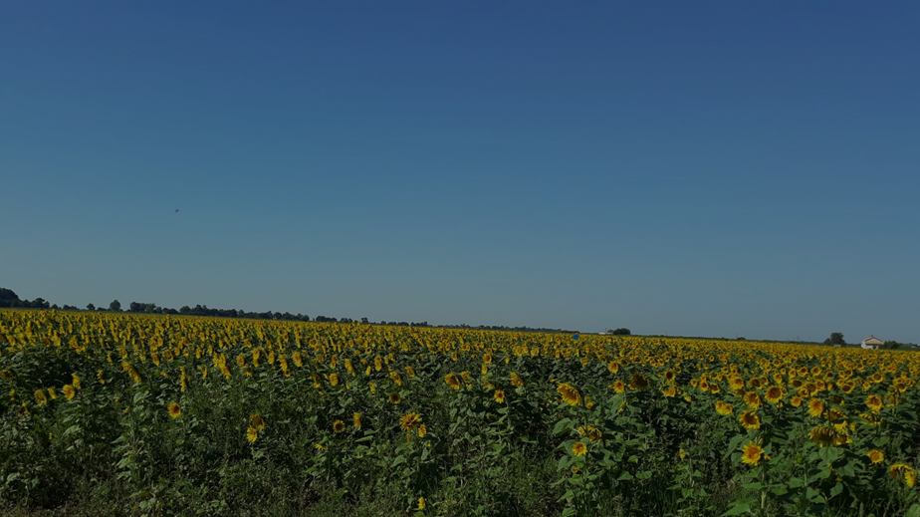
Intercessions
Please add your intercession to Chat –
or raise your hand physically –
or use the Raise Hand “Reaction”
to share the prayer of your heart today.

Slide 14
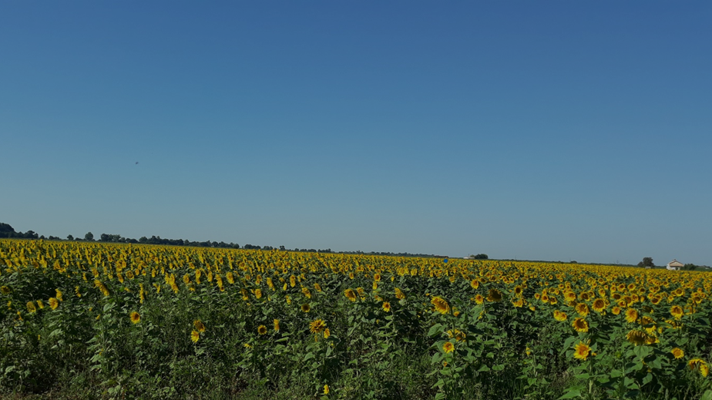
Sowing Seeds of Hope…
The national flower of Ukraine is the sunflower.
From the small seed, a great plant can grow. Its flower blooms like the sun.
Fields of sunflowers glow in the summer sun.
In the harvest, the seeds offer oil to humans and food for creatures in the winter.

Slide 15
Sowing Seeds of Hope…
Our seeds represent the seeds of our hope – for peace – for light – for justice – for mercy – for all that God offers abundantly to his world.

Slide 16
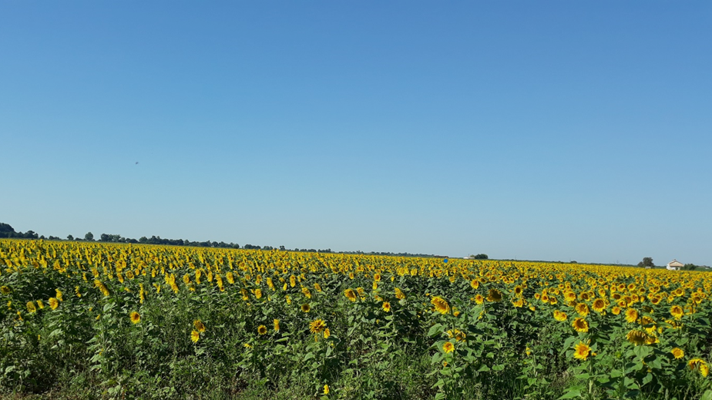
Sowing Seeds of Hope…
We sow our seeds in hope that the sun again will rise in power, peace and joy over Europe.

Slide 17
Closing Responses
Voice 1 Creator God, you gave the sun for our light and our warmth:
All May your children again know the light of your love
and the warmth of your healing.

Slide 18
Closing Responses
Voice 1 Lord, Jesus, you are the Morning Star that heralds a new dawn.
All O Morning Star,
splendour of light eternal and sun of righteousness:
Come and enlighten those who dwell in darkness
and the shadow of death.

Slide 19
Closing Responses
Voice 1 Blessed Spirit, come upon us and the whole of our world –
Especially upon our sisters and brothers in Ukraine.
All May we see again the fruits of your labouring among us:
the fruits of love and joy,
peace and, patience,
kindness and generosity,
faithfulness, gentleness and self-control.

Slide 20
Closing Responses
Voice 1 And may all who are suffering warfare and exile
be this day under the light of God’s blessing.
All Amen

